Slide 1
Rules for Virtual Functions
Virtual functions cannot be static and also cannot be a friend function of another class.
Virtual functions should be accessed using pointer or reference of base class type to achieve run time polymorphism
The prototype of virtual functions should be same in base as well as derived class.
They are always defined in base class and overridden in derived class. It is not mandatory for derived class to override (or re-define the virtual function), in that case base class version of function is used.

Slide 2
class Shape
{
public:
Shape(int l=0, int w=0)
{
length = l;
width = w;
} // default constructor
virtual int get_Area()
{
cout << "This is call to parent class area" << endl;
return 0;
}
protected:
int length, width;
};
// Derived class
class Square : public Shape
{
public:
Square(int l = 0, int w = 0): Shape(l, w)
{
} // declaring and initializing derived class
// constructor
int get_Area()
{
cout << "Square area: " << length * width << endl;
return (length * width);
}
};
// Derived class
class Rectangle : public Shape
{
public:
Rectangle(int l = 0, int w = 0): Shape(l, w)
{
} // declaring and initializing derived class
// constructor
int get_Area()
{
cout << "Rectangle area: " << length * width<< endl;
return (length * width);
}
};
int main(void)
{
Shape* s;
Square sq(5, 5); // making object of child class Sqaure
Rectangle rec(4, 5); // making object of child class Rectangle
s = &sq;
s->get_Area();
s = &rec;
s->get_Area();
return 0;
}

Slide 3
In the above function:
we store the address of each child class Rectangle and Square object in s and
then we call the get_Area() function on it,
ideally, it should have called the respective get_Area() functions of the child classes but
instead it calls the get_Area() defined in the base class.
This happens due static linkage which means the call to get_Area() is getting set only once by the compiler which is in the base class.
What is the use? Virtual functions allow us to create a list of base class pointers and call methods of any of the derived classes without even knowing kind of derived class object.
Consider an employee management software for an organization. Let the code has a simple base class Employee , the class contains virtual functions like raiseSalary(), transfer(), promote(), etc. Different types of employees like Manager, Engineer, etc. may have their own implementations of the virtual functions present in base class Employee. In our complete software, we just need to pass a list of employees everywhere and call appropriate functions without even knowing the type of employee. For example, we can easily raise the salary of all employees by iterating through the list of employees. Every type of employee may have its own logic in its class, but we don’t need to worry about them because if raiseSalary() is present for a specific employee type, only that function would be called.

Slide 4
Explanation: Runtime polymorphism is achieved only through a pointer (or reference) of base class type. Also, a base class pointer can point to the objects of base class as well as to the objects of derived class. In above code, base class pointer ‘bptr’ contains the address of object ‘d’ of derived class.

Slide 5
int main()
{
base* p;
derived obj1;
p = &obj1;
// Early binding because fun1() is non-virtual
// in base
p->fun_1();
// Late binding (RTP)
p->fun_2();
// Late binding (RTP)
p->fun_3();
// Late binding (RTP)
p->fun_4();
// Early binding but this function call is
// illegal(produces error) becasue pointer
// is of base type and function is of
// derived class
// p->fun_4(5);
}
#include <iostream>
using namespace std;
class base {
public:
void fun_1() { cout << "base-1\n"; }
virtual void fun_2() { cout << "base-2\n"; }
virtual void fun_3() { cout << "base-3\n"; }
virtual void fun_4() { cout << "base-4\n"; }
};
class derived : public base {
public:
void fun_1() { cout << "derived-1\n"; }
void fun_2() { cout << "derived-2\n"; }
void fun_4(int x) { cout << "derived-4\n"; }
};
Output:
base-1
derived-2
base-3
base-4
NOTE: fun_4(int) in derived class is different from virtual function fun_4() in base class as prototype of both the function is different.

Slide 6
#include <iostream>
using namespace std;
class Base
{
public:
~Base() //non-virtual destructor
//virtual ~Base() //virtual destructor
{
cout << "Base destroyed\n";
}
};
////////////////////////////////////////////////////////////////
class Derv : public Base
{
public:
~Derv()
{
cout << "Derv destroyed\n";
}
};
int main()
{
Base* pBase = new Derv;
delete pBase;
return 0;
}

Slide 7
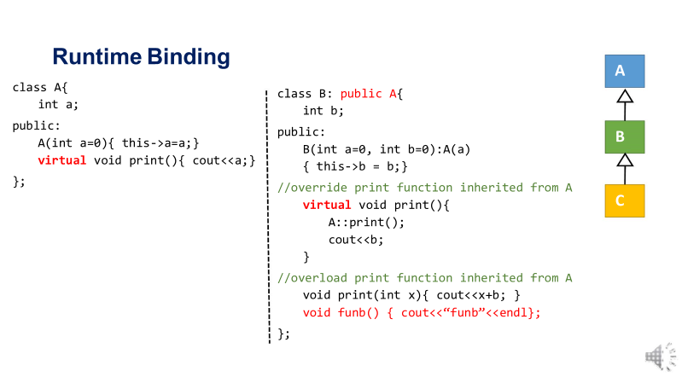

Slide 8
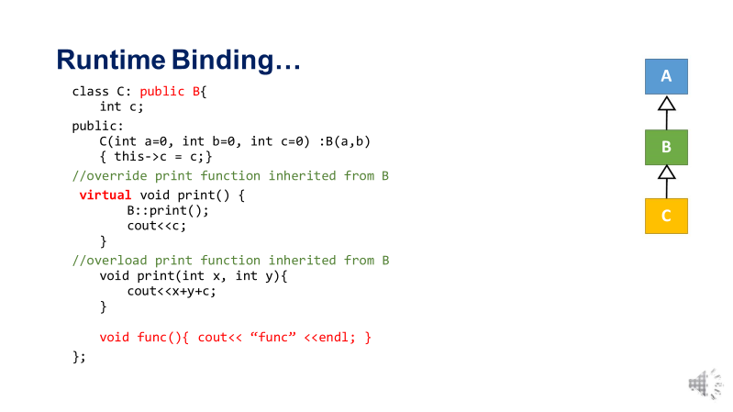

Slide 9
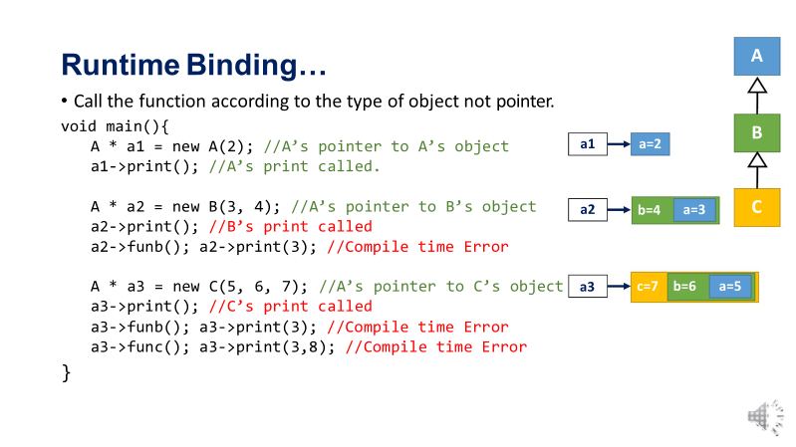

Slide 10
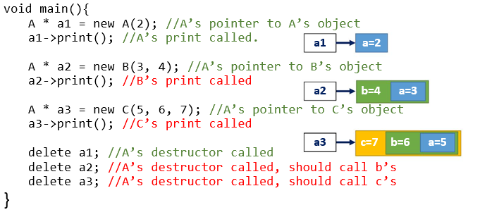
Virtual Destructor

Slide 11
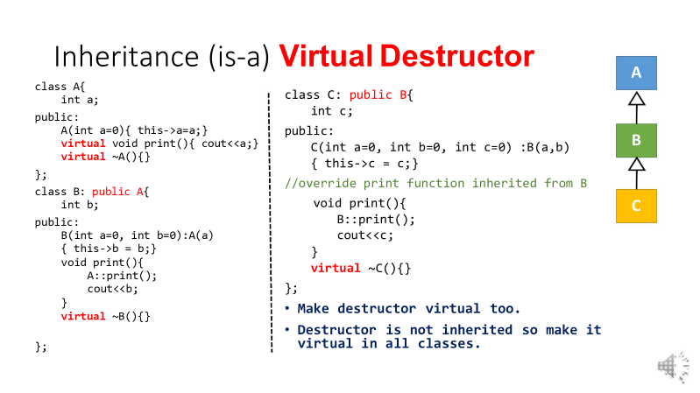
Virtual Destructor

Slide 12
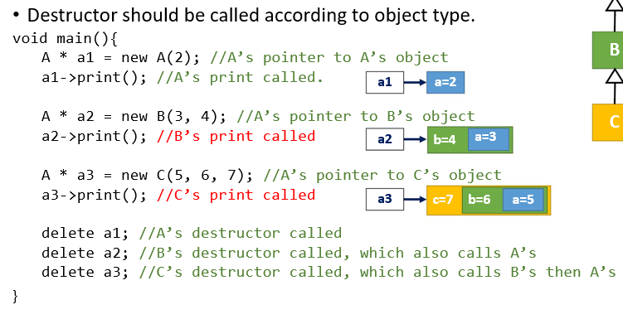
Virtual Destructor

Slide 13
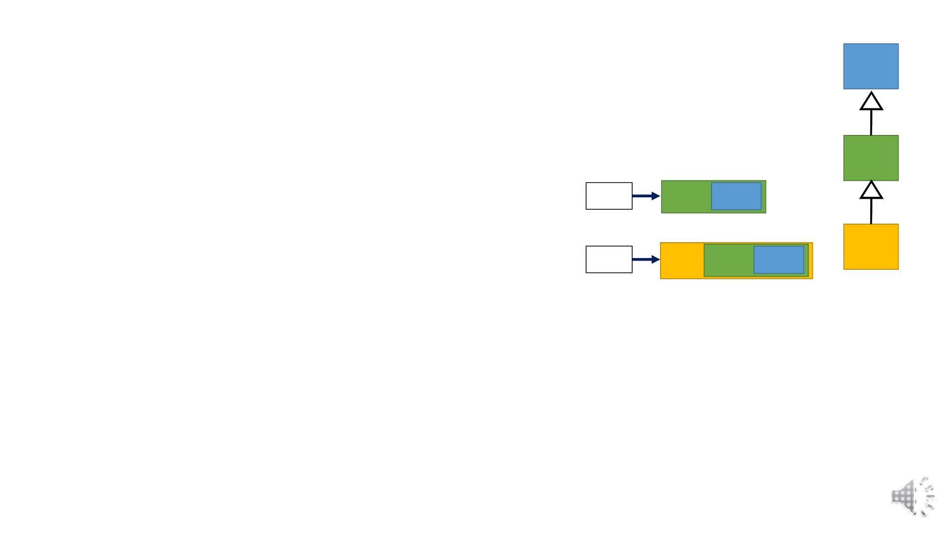
Virtual Destructor
Virtual Destructor
A
B
C
void main(){
B * b1 = new B(9, 10); //B’s pointer to B’s object
b1->print(); //B’s print called.
b1
b=10 a=9
B * b2 = new C(5, 60, 70); //B’s pointer to C’s object
b1->print(); //C’s print called.
b2
c=70 b=60 a=5
B * b3 = new A(2); //Error: B’s pointer to A’s object
//Every derived is a base but every base is not a derived.
//Allowed if explicit cast made
delete b1; //B’s destructor called, which also calls A’s
delete b2; //C’s destructor called, which also calls B’s then A’s
}

Slide 14
virtual table and vptr
The virtual table is a lookup table of functions used to resolve function calls in a dynamic/late binding manner.
First, every class that uses virtual functions (or is derived from a class that uses virtual functions) is given its own virtual table. This table is simply a static array that the compiler sets up at compile time. A virtual table contains one entry for each virtual function that can be called by objects of the class. Each entry in this table is simply a function pointer that points to function accessible by that class.
Second, the compiler also adds a hidden pointer that is a member of the base class, which we will call *__vptr. *__vptr is set (automatically) when a class instance is created so that it points to the virtual table for that class.

Slide 15
virtual table and vptr
class Base
{
public:
VirtualTable* __vptr;
virtual void function1() {};
virtual void function2() {};
};
class D1: public Base
{
public:
virtual void function1() {};
};
class D2: public Base
{
public:
virtual void function2() {};
};

Slide 16
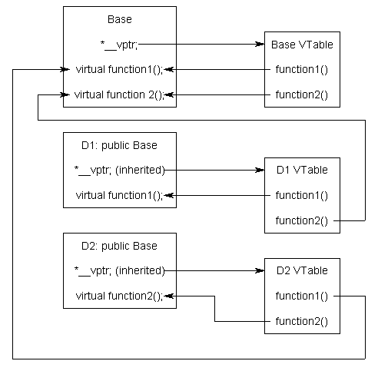
virtual table and vptr

Slide 17
Upcasting
Simple assigning base class pointers to the child object or base class as an alias to child class object.
Downcasting
It manually cast the base class's object to the derived class's object, so we must specify the explicit typecast.

Slide 18
Downcasting
It manually cast the base class's object to the derived class's object, so we must specify the explicit typecast
int main ()
{
Parent pobj; // create Parent's object
Child *cobj; // create Child's object
// explicit type cast is required in
downcasting
cobj = (Child *) &pobj;
cobj -> derive();
return 0;
}
class Parent
{
public:
void base()
{
cout << " It is the function of the Parent class "<< endl;
}
};
class Child : public Parent
{
public:
void derive()
{
cout << " it is the function of the Child class " <<endl;
}
};

Slide 19
Classes we have worked on till now are concrete classes.

Slide 20
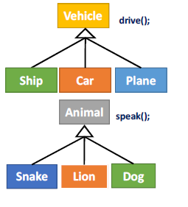
Abstract classes
Abstract class is a concept not a real object,
Class Shape{
Point p;
public:
Shape(int x=0,int y=0):p(x,y){}
virtual void draw(){//What to draw?}
};
Class Vehicle{
public:
virtual void drive(){// What to drive?}
};
Class Animal{
public:
Virtual void speak(){// What to speak?}
};

Slide 21
Abstract classes
Think about a playing card. It doesn’t matter what game we’re playing, all cards have a few things that are the same. The suit & the face. But, cards also have some sort of the value to the game they’re being used in. But for that, you need to know the game.
class BlackJackCard : public Card {
public: int getValue() {
return getFace() >= 10 ? 10 : getFace();
}
}
class Card {
protected:
int face;
String suit;
public :
Card() { /* Implementation not shown */ }
int getFace() { return face; }
String getSuit() { return suit; }
virtual int getValue()=0;
}
class CrazyEightsCard : Public Card {
public: int getValue() {
// I haven't played crazy eights in years and have
// no idea what would really go here :)
}
}
Notes:
We didn’t have to reimplement the getFace or getValue method because that’s taken care of in the abstract class Card.
And I can use the same Card class as a parent for any card game that I make, just reimplementing the getValue method for whatever game I build.

Slide 22
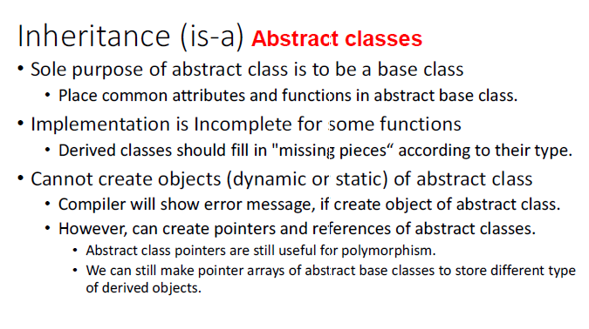

Slide 23
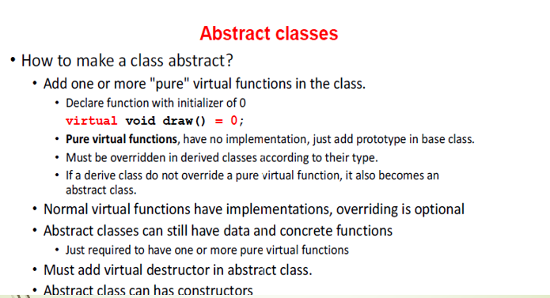

Slide 24
class Shape{
Int x;
Int y;
public:
Shape(int x=0, int y=0) :p(x,y){}
virtual void draw() = 0; // Pure virtual function
};
class Vehicle{
public:
virtual void drive() = 0; // Pure virtual function
};
class Animal{
public:
virtual void speak() = 0; // Pure virtual function
};

Slide 25
void main(){
Shape * s = new Shape(3, 2); //Error: cannot create object of abstract class.
// Can still point to derived class objects.
Shape * s2 = new Circle(3, 2, 5.5);
s2->draw(); // Draw a circle
Shape * s3 = new Rectangle(3, 2, 5.5, 6);
s3->draw(); // Draw a Rectangle
Animal * a = new Animal;//Error
Animal * a2 = new Lion;
a2->speak(); // Lion Roars
Vehicle * v = new Vehicle; //Error
}

Slide 26
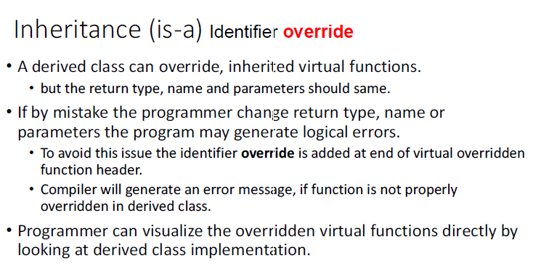

Slide 27
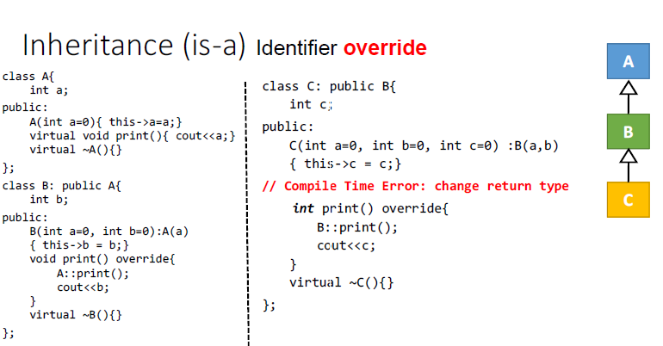

Slide 28
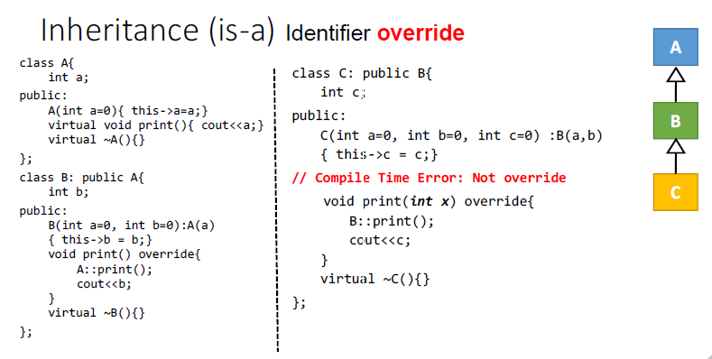

Slide 29
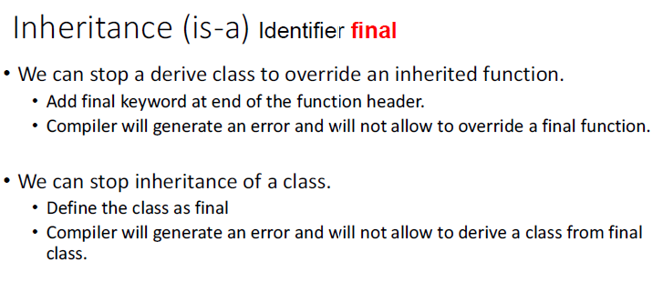

Slide 30
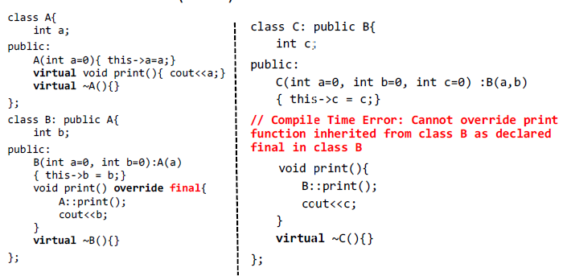

Slide 31
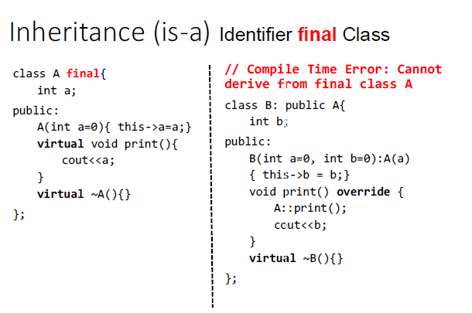

Slide 32
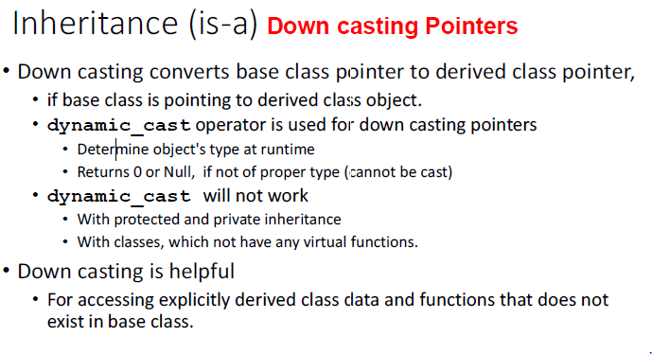

Slide 33
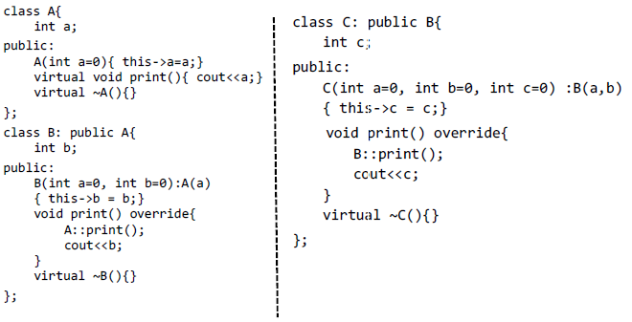

Slide 34
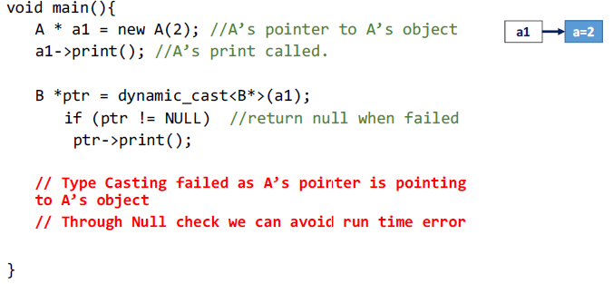

Slide 35
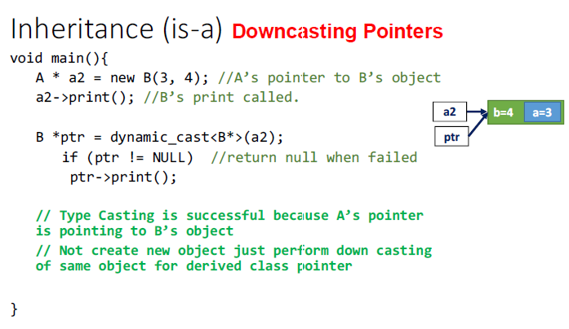

Slide 36
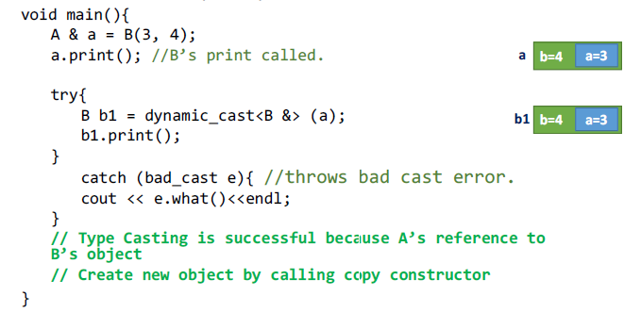
Down casting References

Slide 37
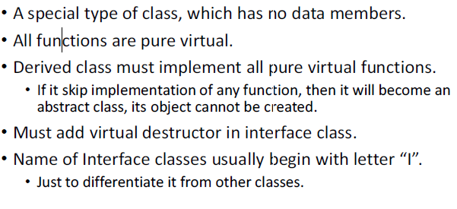
Interface

Slide 38
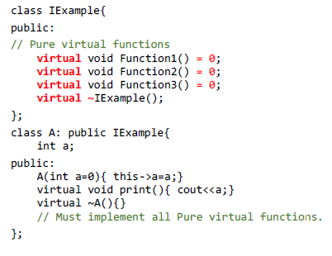
Interface

Slide 39
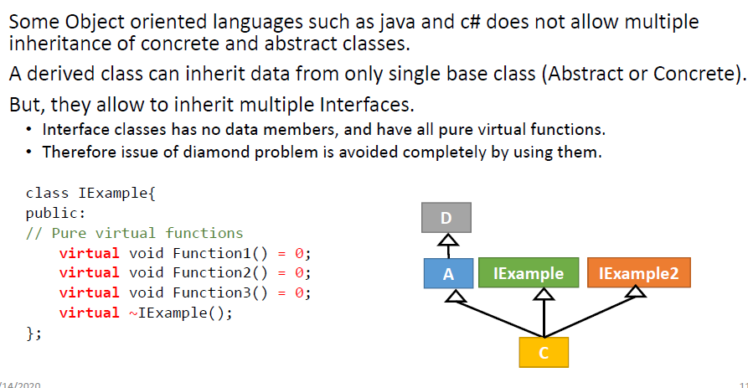
Interface with diamond problem

Slide 40
Forward declarations
class A;
class B;
class B {
int x;
public:
void getdata(int n)
{
x = n; }
friend int sum(A, B);
};
class A {
int y;
public:
void getdata(int m)
{
y = m;
}
friend int sum(A, B);
};
int sum(A m, B n)
{
int result;
result = m.y + n.x;
return result;
}
int main()
{
B b;
A a;
a.getdata(5);
b.getdata(4);
cout << "The sum is : " << sum(a, b);
return 0;
}

